Slide 1
TravelTide: Customer Insight
L.G.

Slide 2
Introduction
TravelTide’s marketing team wants to develop a rewards program tailored to the users

Slide 3

Perks
Free Hotel Meal
Free Checked Bag
Free Cancellation
Exclusive Discounts
One Night Free Hotel with Flight

Slide 4

Objectives
Identify and Segment customers based on data (booking behaviour)
Tailor provided perks to meet preferences of identified segments

Slide 5
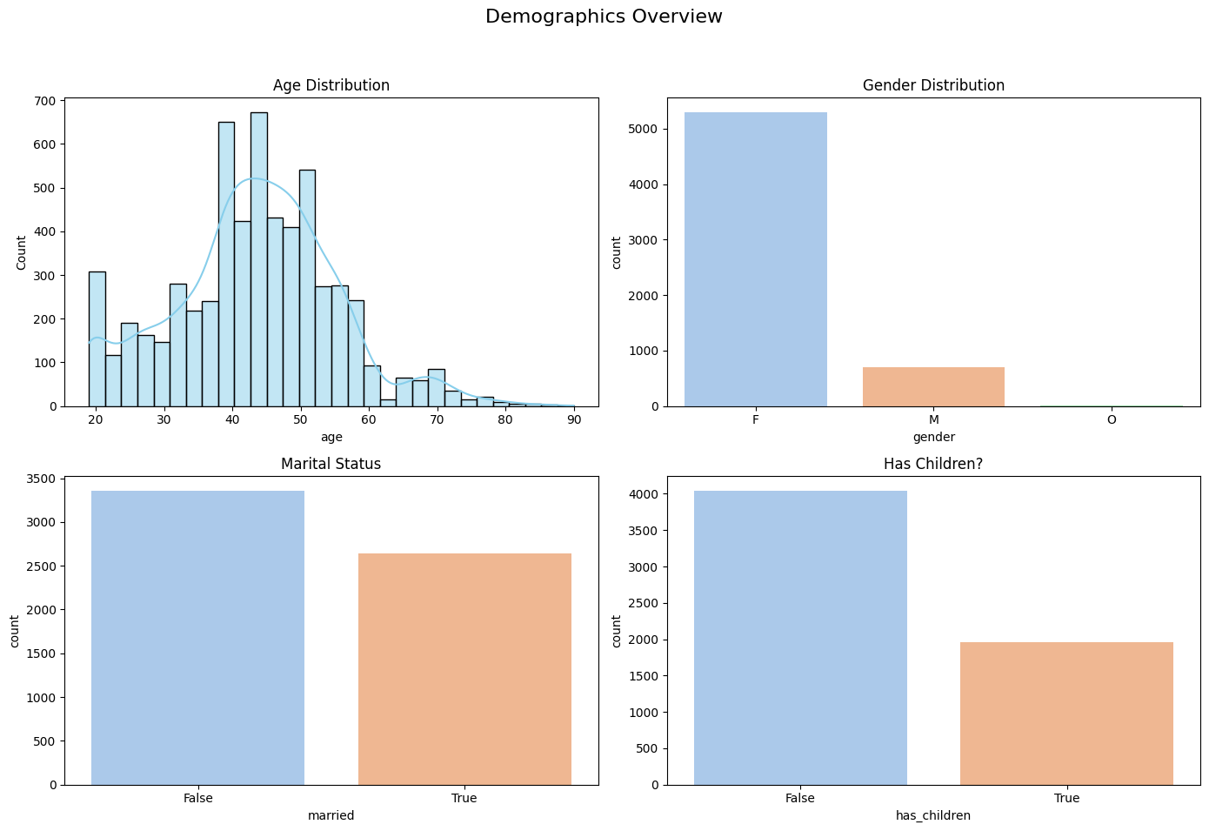
Exploratory Data Analysis

Slide 6
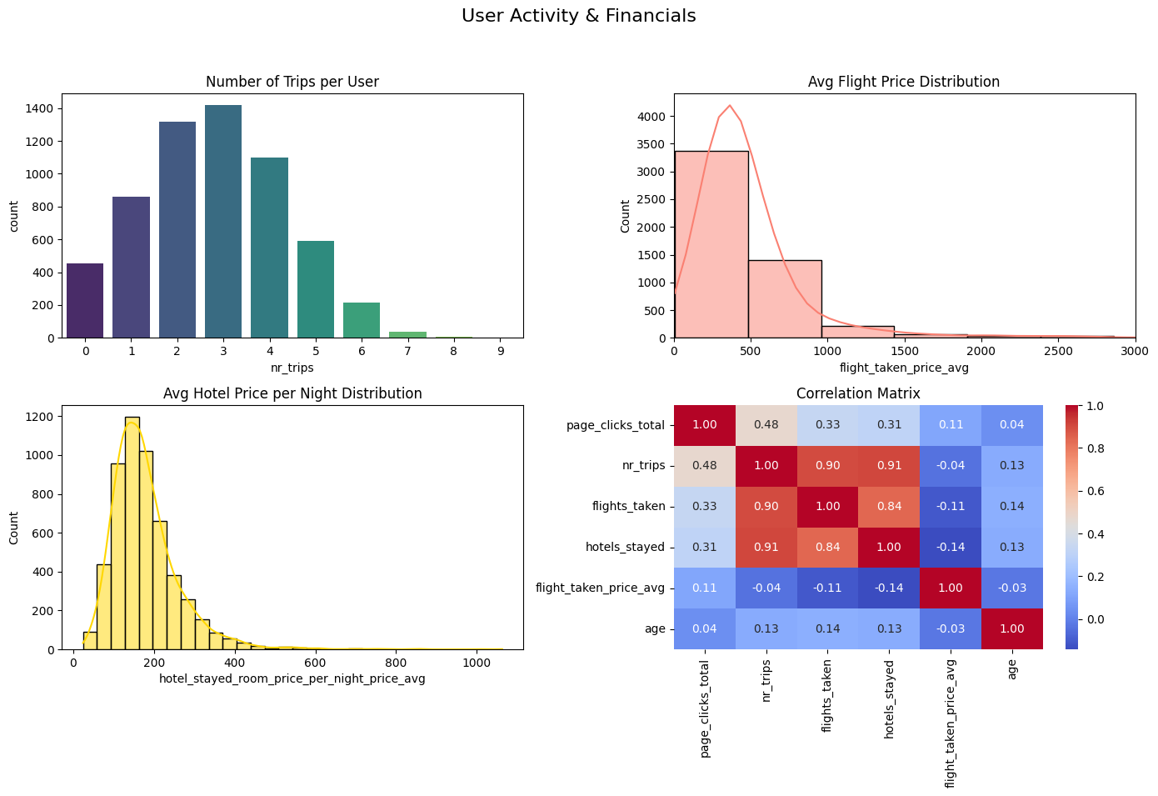
Exploratory Data Analysis

Slide 7
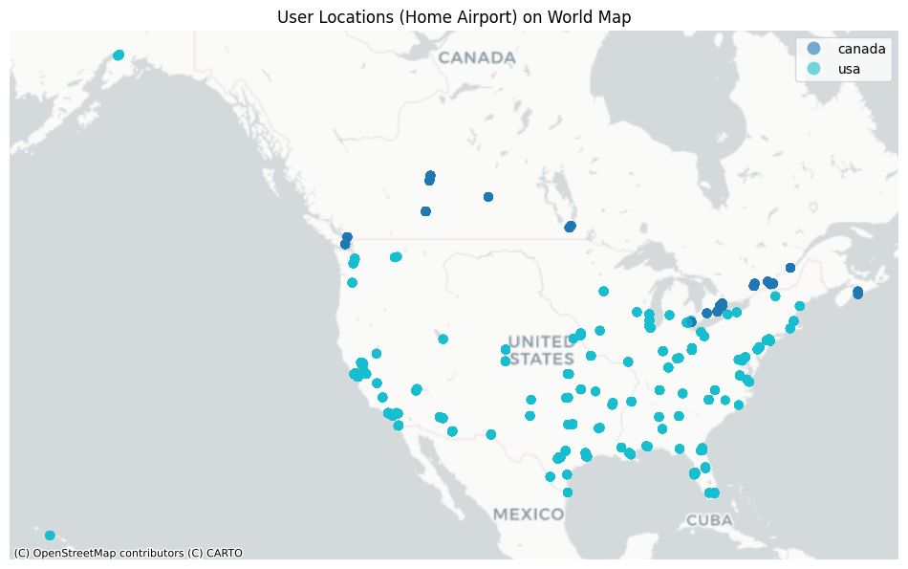
Exploratory Data Analysis

Slide 8
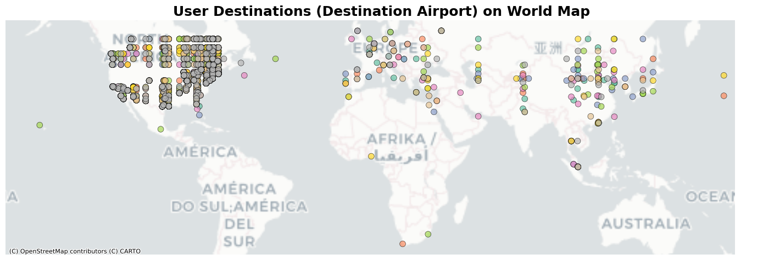
Exploratory Data Analysis

Slide 9

Analysing the Data (Methods Used)
CLTV
Kmeans
Heatmap
RFM

Slide 10
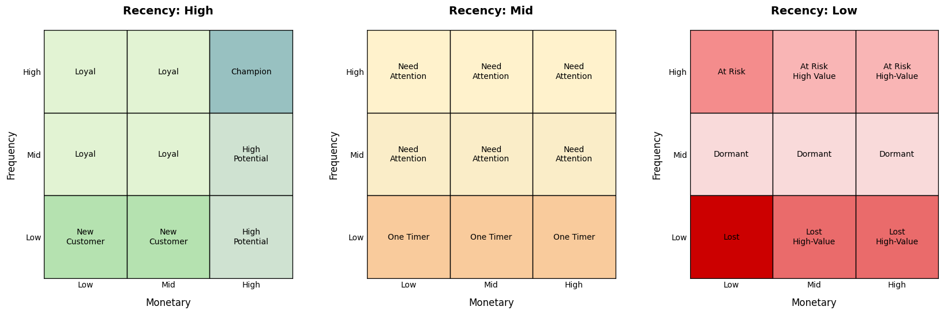
RFM (Recency, Frequency, Monetary)

Slide 11
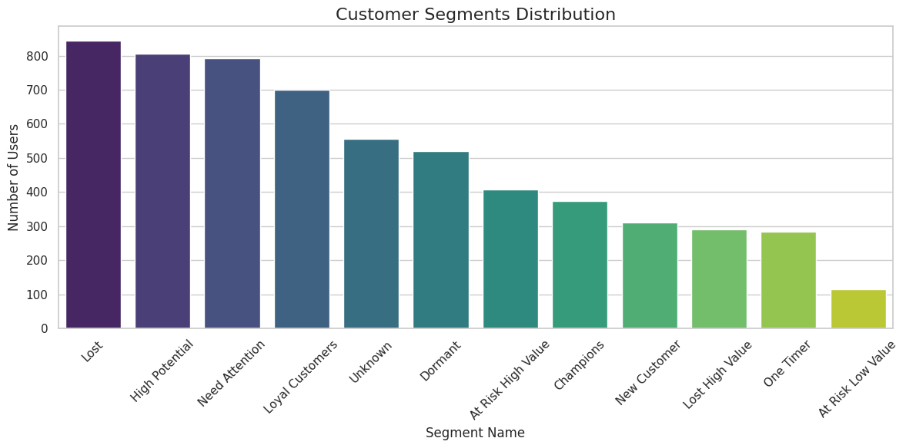
RFM (Recency, Frequency, Monetary)

Slide 12
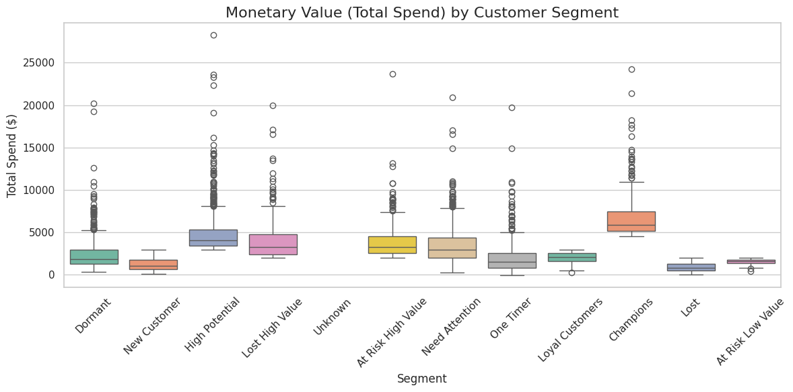
RFM (Recency, Frequency, Monetary)

Slide 13
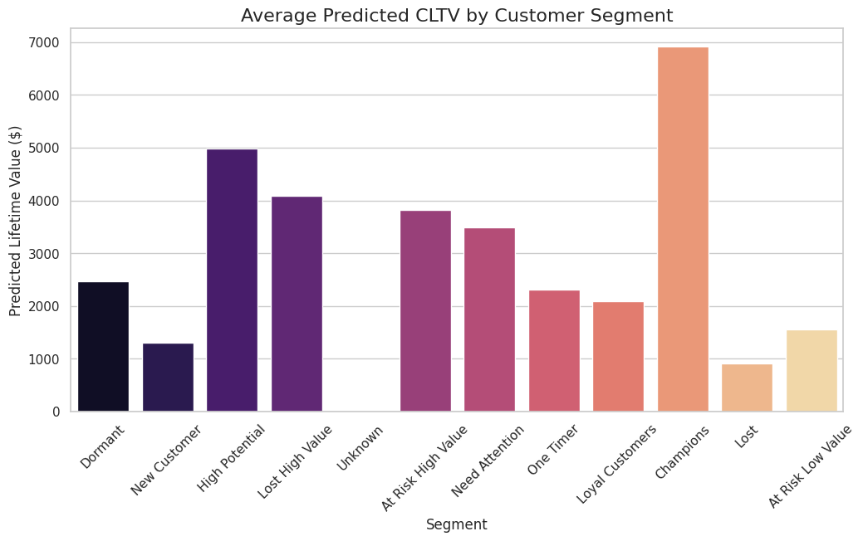
Customer LifeTime Value

Slide 14
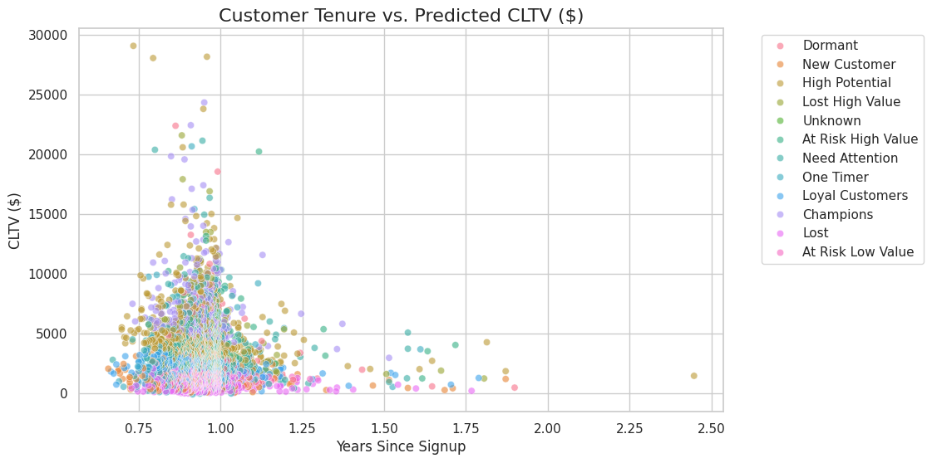
Customer LifeTime Value

Slide 15
RFM & CLTV Insights
Not Detailed enough to assign proper perks
Too Many Groups
Other conclusions can be drawn
Many Unknowns
Many Lost & Need attention
Also Many High Potential & Loyal Customers
Mostly relatively new signups

Slide 16
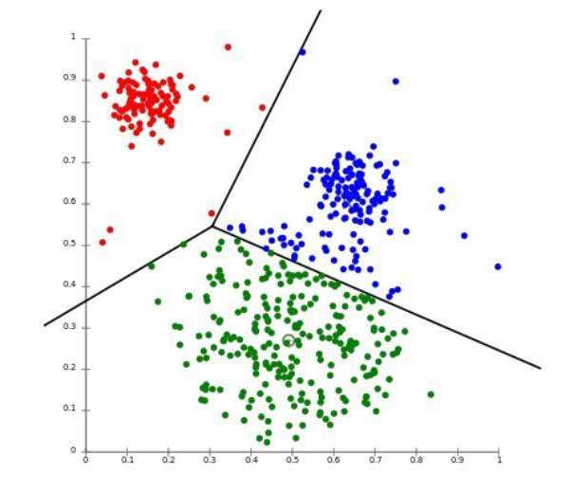
K-means
Machine learning algorithm
Grouping Data in clusters

Slide 17
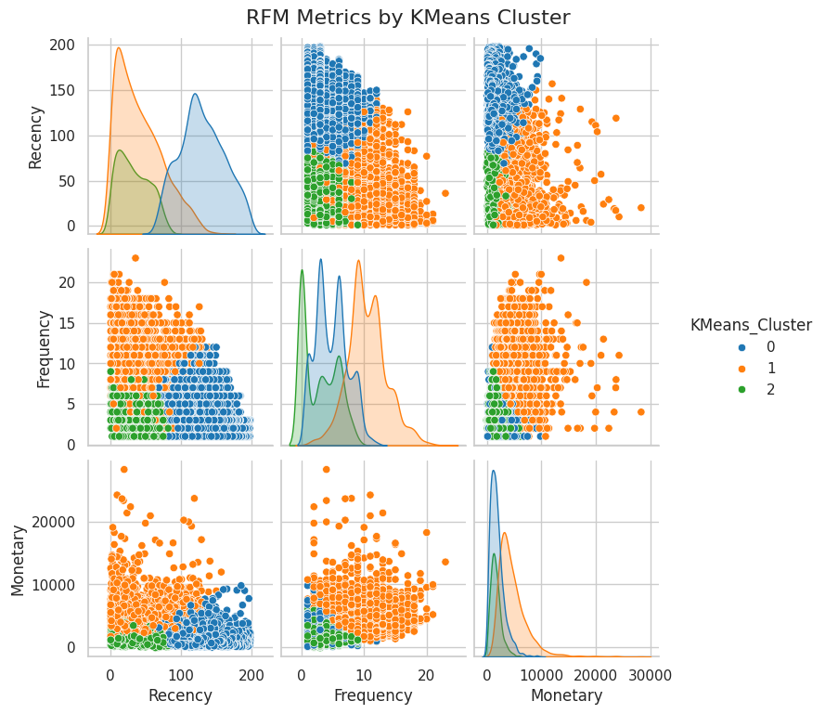
K-means Based On RFM

Slide 18
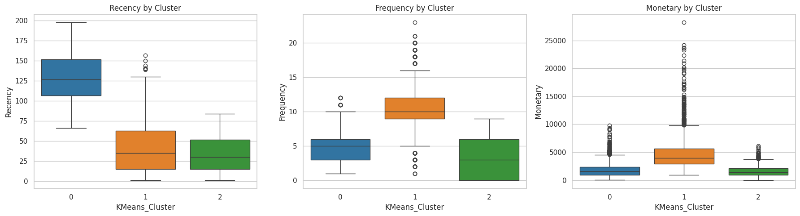
K-means Based On RFM

Slide 19
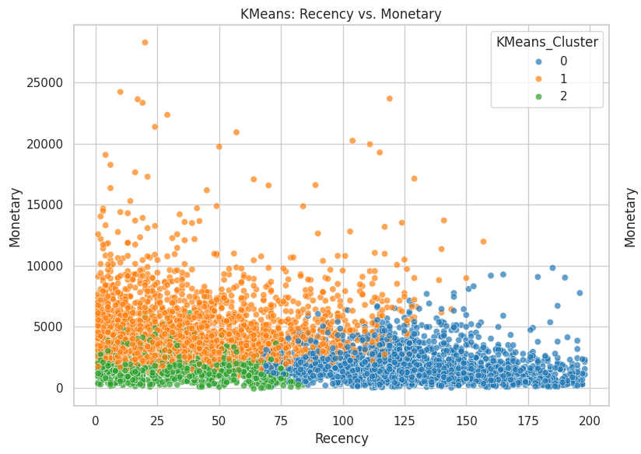
K-means Based On RFM

Slide 20
Findings Based On K-means
Optimal Clusters/Segments = 3
Interesting Insights
Requires more depth

Slide 21
K-means + Selected Features
5 Clusters
5 Perks

Slide 22

Features Selected:
Proportion of Cancellations
Percentage of Checked Bags
Length of Trip
Hotel Booking Frequency
Average Dollars Saved

Slide 23
Perks:
Free Hotel Meal
Free Cancellation
Exclusive Discounts
One Night Free Hotel with Flight
Free Checked Bag

Slide 24
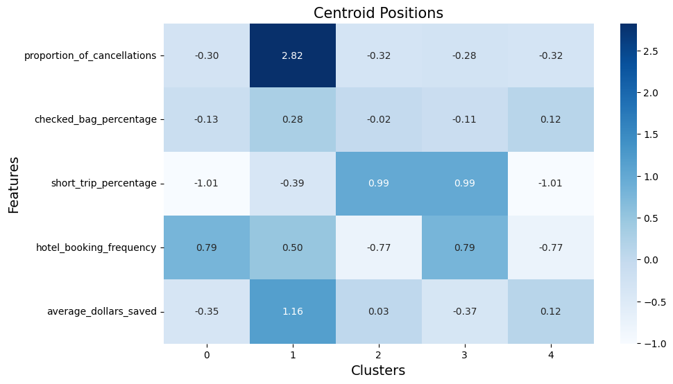
K-means + Features Heatmap

Slide 25
Cluster 0: Free Cancellation

Slide 26
Cluster 0: Free Cancellation
Long Trips + Many Hotel Bookings
Potentially benefit most of the Free Cancellation Perk because of the number of trips

Slide 27
Cluster 1: Exclusive Discounts

Slide 28
Cluster 1: Exclusive Discounts
Highest cancellations by far
Shows they do not mind paying the cancellation fees
Free cancellation perk = Loss of income
Average dollars saved = highest too
Discounts much more enticing

Slide 29
Cluster 2: One Night Free Hotel With Flight

Slide 30
Cluster 2: One Night Free Hotel With Flight
Travelers favour short trips
Infrequent booking
Possible short holidays, visiting friends or family, or travelers with smaller budgets
Perk can incentivize travelers to book more frequently

Slide 31
Cluster 3: Free Hotel Meal

Slide 32
Cluster 3: Free Hotel Meal
Travelers favour short trips
Very frequent bookings
Possible business trips
Can feel stressed
Perk offers convenient breakfast or dinner solutions
Perk advantageous for travelers with limited time.

Slide 33
Cluster 4: Free Checked Bag

Slide 34
Cluster 4: Free Checked Bag
Travelers show interest in saving money + checking in bags
Perk allows for a welcoming money-saving deal
Relatively Similar to Cluster 0

Slide 35
Cluster Sizes
Cluster 2 (One Night Free Hotel With Flight): 1270
Cluster 4 (Free Checked Bag): 1165
Cluster 3 (Free Hotel Meal): 1088
Cluster 0 (Free Cancellation): 973
Cluster 1 (Exclusive Discounts): 490

Slide 37
Recommendations

Slide 38
Combining Clusters/Perks
Simplify Rewards Program
Reduce Redundancy
Aligns with Optimal Clusters (3)
Enhance Coherence

Slide 39
Clusters have similarities:
One Night Free Hotel With Flight
Free Hotel Meal

Slide 40
Clusters have similarities:
Free Cancellations
Free Checked Bag

Slide 41
Multi-leveled Rewards Program
Varying perks for different stages of engagement
Promote Loyalty
Can be applied based on RFM findings

Slide 42
Feedback Mechanism
Lot of unknowns (seen in CLTV)
Proactive approach
Finetune program to stay relevant to preferences
Possible Reward for completion of feedback (E.g. Loyalty points, small discount)

Slide 43
Feedback Mechanism
Lot of unknowns (seen in CLTV)
Proactive approach
Finetune program to stay relevant to preferences
Possible Reward for completion of feedback (E.g. Loyalty points, small discount)

Slide 44
Diversify Genders
Strategies directed towards men
Retain female users

Slide 45
Special Promotions for domestic Flights

Slide 46
Thank you for your attention!

